Slide 1
COMMISSIONER CABINET
Monthly Training

Slide 2
Michael Marks
Chief Joker
Webelos-To-Scouts Transition

Slide 3
Webelos-to-Scouts Transition
Notes:
To avoid the pitfall of shrinking membership, a troop should add at least 10 new Scouts every year.
Having a year-round growth plan in place will help attract new Scouts.
There are three main methods of recruiting new Scouts into troops:
• Graduate Webelos Scouts into a Boy Scout troop.
• Host a troop open house.
• Encourage boy-to-boy recruiting.
Remember – 90% of all Boy Scouts come from Cub Scouts.
The W-T-S transition is essential to our success. We MUST pay attention to the players and process!

Slide 4
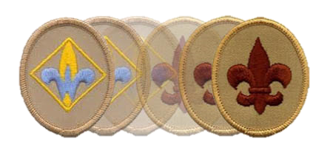
Webelos-to-Scouts
One of Scouting’s greatest challenges is to make the next level of Scouting readily available for a young man once he meets the joining requirements.
Notes:
One of Scouting’s greatest challenges is to make the next level of Scouting readily available for a young man once he meets the joining requirements.

Slide 5
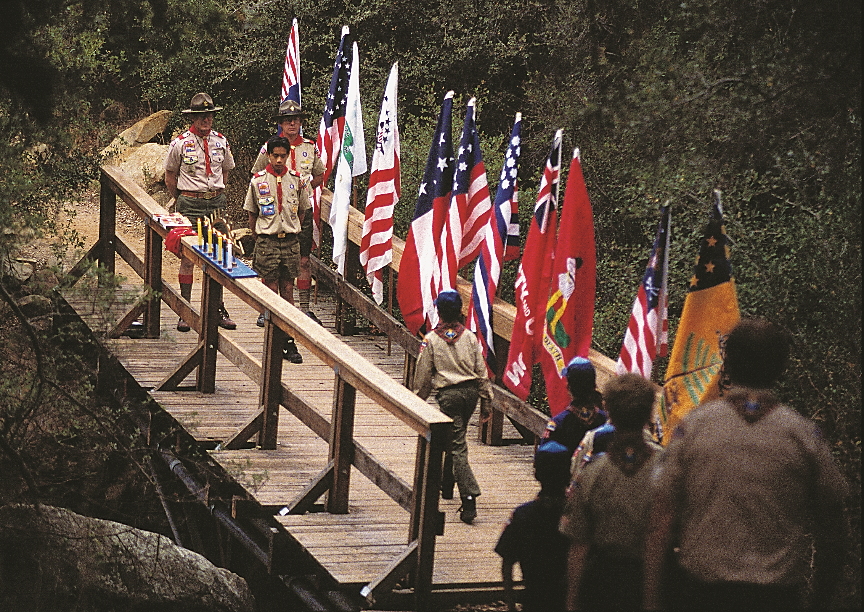
Notes:
The key factor to improved Webelos transition is the ongoing working relationship of the leaders of a Cub Scout pack and a Boy Scout troop.
Ideally a community organization would have both a pack and a troop with leaders who work together to help move Webelos Scouts into a Boy Scout troop the same way schools move students from elementary school to middle school.

Slide 6
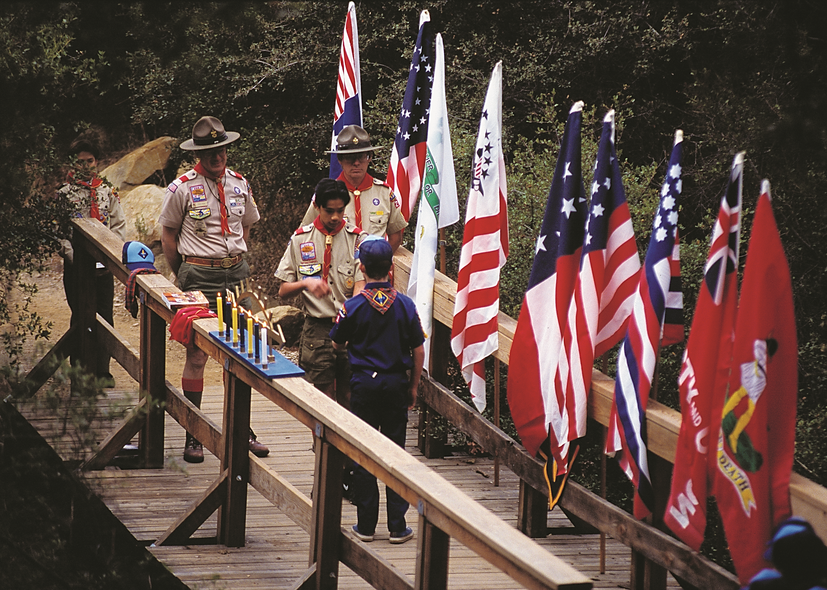
Notes:
The passage from Cub Scout pack to Boy Scout troop should be smooth, with no time lost in between.
By the time Webelos Scouts are ready to cross over, they and their families should be familiar and comfortable with the youth and adult leaders of the troop, their role in the troop and troop activities, and feel excited about beginning this new adventure.

Slide 7
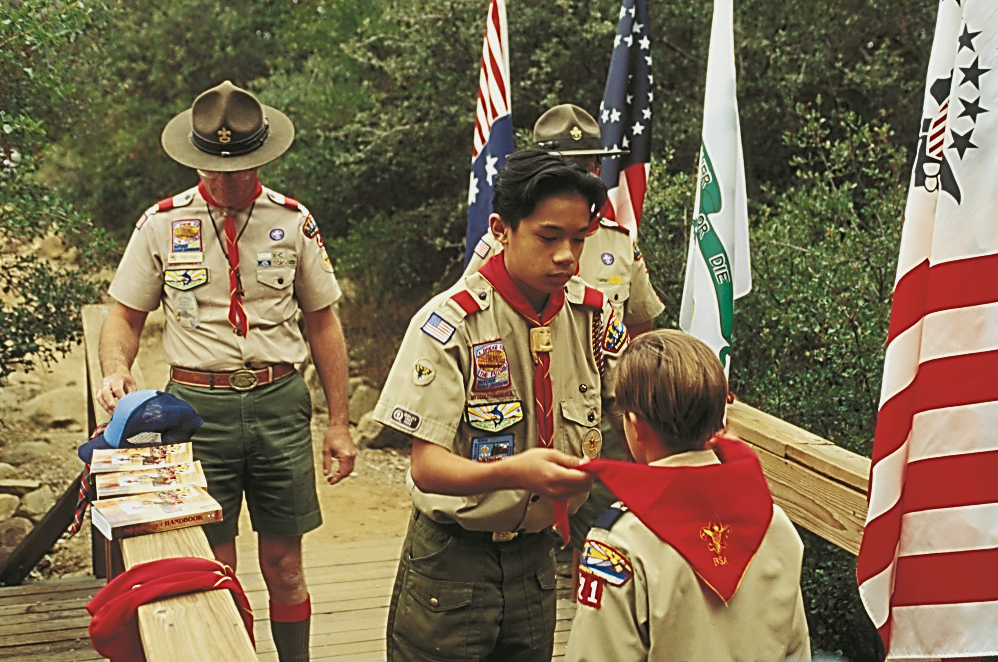
Notes:
The Webelos Scout’s graduation ceremony should clearly signify his transition to a new level of Scouting, and could include the presentation of his Arrow of Light Award, a Boy Scout Handbook, and a troop neckerchief.

Slide 8
Webelos-to-Scouts
GOAL: 100% Crossover!
Notes:
It should be the goal of the Cubmaster and Webelos den leaders to graduate every Webelos Scout into a Boy Scout troop.
The key to accomplishing this is to begin promoting Boy Scouting when Cub Scouts are still in their Tiger, Wolf, and Bear dens, and to sell the sizzle of the great outdoors.

Slide 9
Webelos-to-Scouts
Who:
Unit Commissioner is the connecting link in the chain between the Troop and the Pack
Notes:
The Unit Commissioner is the connecting link in the chain between the Troop and the Pack

Slide 10
Webelos-to-Scouts
Who else?
Cub Scout Pack
Boy Scout Troop
District W-T-S Chair
Notes:
There are a number of ways a pack and troop can work together to enhance the Scouting experience of their boys. To help assure
maximum transition requires cooperation between the other players:
■ Boy Scout troop
■ Cub Scout pack
■ District Webelos transition chair

Slide 11
Webelos-to-Scouts
Why:
Give all Webelos Scouts a chance to experience the fun and excitement of Boy Scouting.
Notes:
Why:
The longer a boy stays involved in Scouting, the more the attributes of character development, citizenship, and fitness are demonstrated.

Slide 12
Webelos-to-Scouts
When:
Year Round Process
Monthly Action Items
Begins Long Before Crossover!
Notes:
When:
Year Round Process with Monthly Action Items
A lot depends on the pack crossover date (BSA recommends February Blue & Gold/Crossovers)
To be successful, the process of WTS begins long before drossover!

Slide 13
Webelos-to-Scouts
Commissioner How:
Catalyst: develop good relationships between troop & pack leaders
Promote communication via meeting of key volunteers
Help plan Webelos to visit troop meeting & joint activities
Notes:
How:
1) Be a catalyst in developing good relationships between troop and pack leaders.
2) Promote communication by scheduling a meeting of key volunteers.
3) Help plan a Webelos den visit to a troop meeting and other joint activities.

Slide 14
Webelos-to-Scouts
Commissioner How:
Assure crossover ceremony at blue and gold banquet
Attend crossover ceremony
Be sure new Scouts:
Have completed application
Copy of the troop’s activities
Know when/where troop meets
Notes:
How:
4) Keep the pack and troop on schedule as plans develop for the crossover ceremony at the blue and gold banquet.
5) Attend the crossover ceremony.
6) Be sure new Scouts have completed a Boy Scout application, that they have a copy of the troop’s activities, and that they know when and where the troop meets.

Slide 15
Webelos-to-Scouts
Commissioner How:
Ensure Webelos move from pack rosters to troop rosters
Work with Webelos transition chair to make sure boys don’t fall through cracks
Assure Webelos join troop in time for summer camp
Notes:
8) Work with the pack and troop in their charter renewal process to help ensure Webelos Scouts are moved from pack rosters to troop rosters.
9) Work with the Webelos transition chair to follow up on boys who have not yet joined a troop. Make sure they are invited to join a troop.
10) Be sure Webelos Scouts join a troop in time to prepare for Boy Scout summer camp.

Slide 16
Webelos-to-Scouts
Other Players - How:
PACK: work with troop(s)
TROOP: assign SA, Den Chief
DISTRICT: coach, track, report
ALL: communicate/coordinate
#18-086
Notes:
This is a brief overview of the other players in the WTS transition process.
PACK: work with troop(s) – sell the sizzle of Scouting from the time they join to the time they crossover.
TROOP: assign an Assistant Scoutmaster to each pack to coordinate and communicate event. Assign a Den Chief to each Den to set the example for the Cubs.
DISTRICT WTS person is on the membership committee. Their job is to coach the leaders (more Cub than Troop), track progress, report results – work with UC to make sure no one falls through the cracks!
ALL: communicate/coordinate frequently!
Please rad the publication 18-086 for a full listing what each player should do…

Slide 17
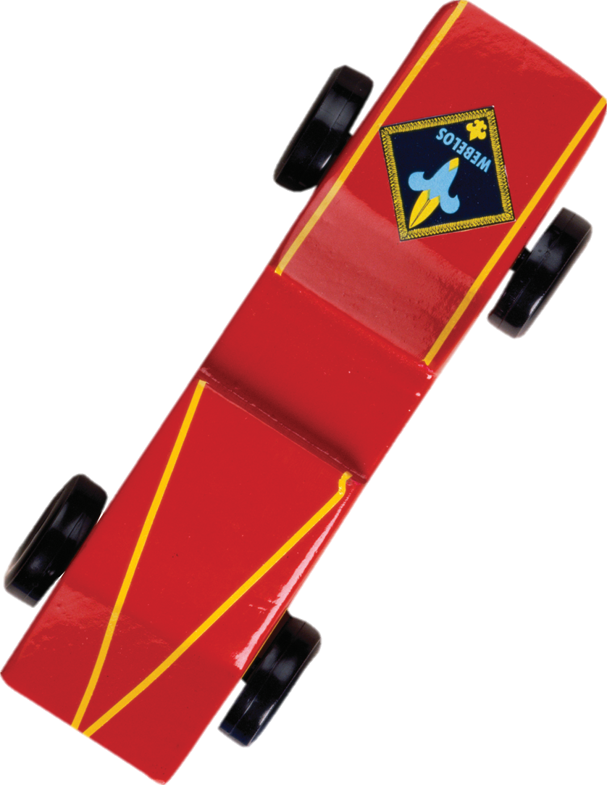
Webelos-to-Scouts
Resources
Brochures, Videos, Manuals, Calendars
Commissioner-BSA.org/wts
Notes:
Commissioner-BSA.org/wts
A smorgasbord of information and tools to help you, help your units!

Slide 18
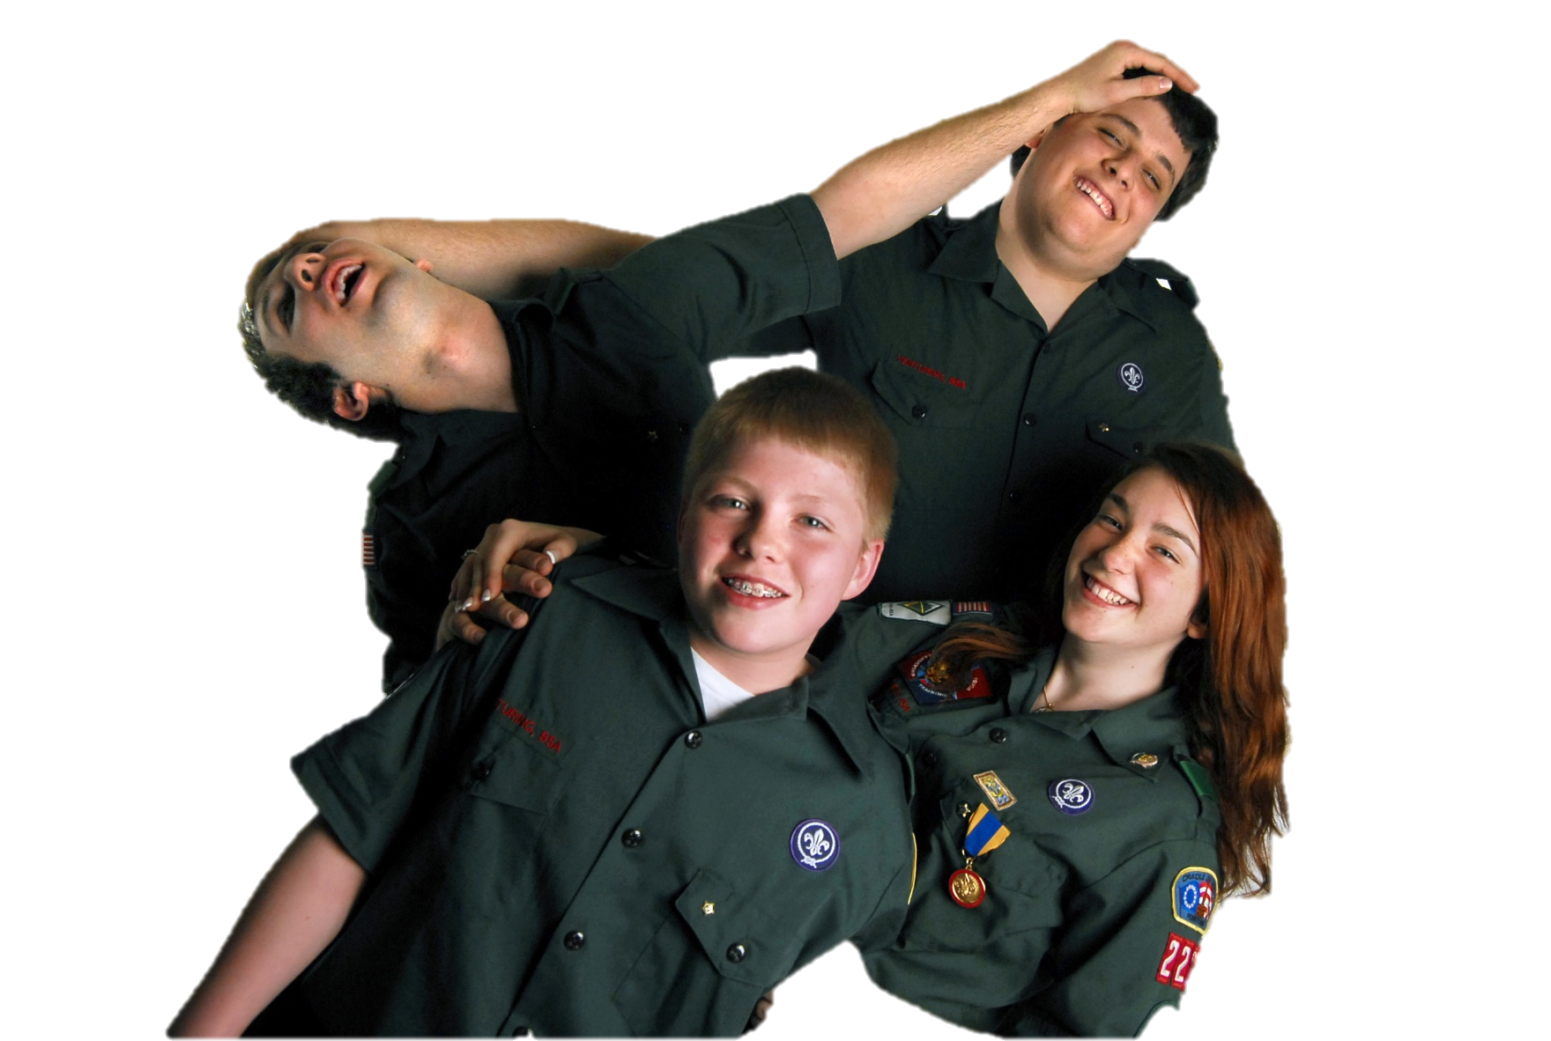
Maybe Someday...
Scout-To-Venturer
Notes:
Scouting should be viewed as an ongoing adventure, and the progression should be as normal as moving from elementary school to middle school.
Eventually, this should include the graduation to an older-youth program.

Slide 19
Coming Soon…
May, 2014
Notes:
Look for the “re-tooled” Venturing program to be announced next year.

Slide 20
Discuss!
Notes:
The Outcome
• Help make the Webelos-to-Scout transition seamless.
• Give all Webelos Scouts a chance to experience the fun and excitement of Boy Scouting.

